Slide 1
SoSafe Home Security Systems
COEN359 – Design Patterns Project
-By
He Shouchun (Kenny)
Sakshi Singh

Slide 2
Project Definition
Home Security System
GUI Console (For system Administrator) + Remote Login (End Client)
2 Types of sensor – Door & Temperature with corresponding alarms
User add map and install any of the sensors. Enable/ Disable sensors
Current bill + Bill History

Slide 3
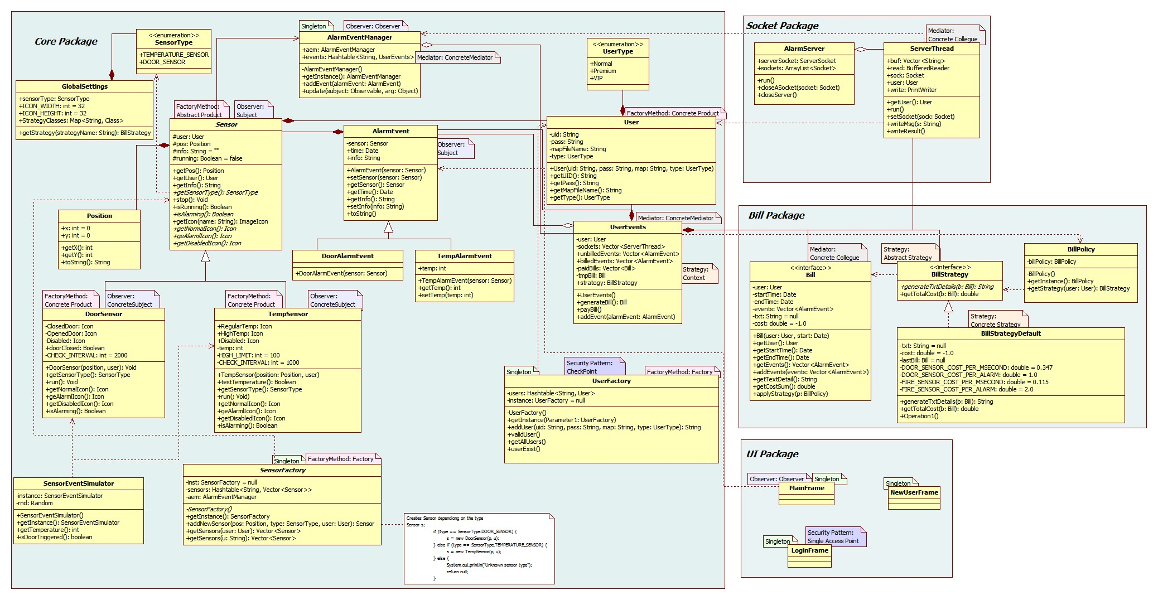
Class Diagram

Slide 4
class GlobalSettings
This class defines the global constants used by other classes.
Follows OCP – All extension changes in this class. Actual implementation need not be changed.
Effectively used for Bill Strategy and Sensor Type in current implementation.

Slide 5
Mediator pattern UserEvents
public class UserEvents {
private User user;
private Vector<ServerThread> sockets = new Vector<ServerThread>();
// For synchronization. No ArrayList.
private Vector<AlarmEvent> unBilledEvents = new Vector<AlarmEvent>();
private Vector<AlarmEvent> billedEvents = new Vector<AlarmEvent>();
private Vector<Bill> bills = new Vector<Bill>();
private Date lastBillDate = null;
private Bill bill = null; // A latest bill.
BillStrategy strategy;
private synchronized void dispatchMsgToSocket(String msg) {
for (ServerThread st: sockets) {
st.writeMsg(msg);
}
}

Slide 6
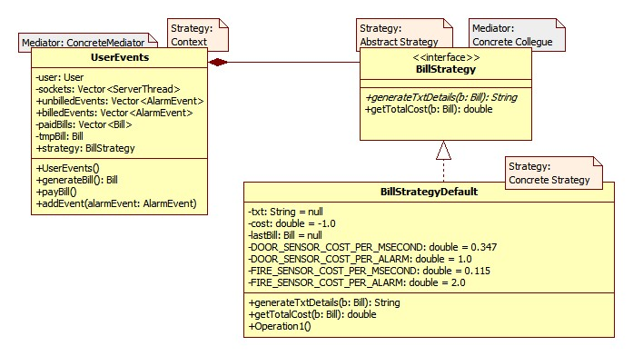
Strategy pattern Bill Strategy
Different bill strategies for different types of users.
For now implemented default strategy.
Interface BillStrategy – Abstract Strategy, BillStrategyDefault – Concrete Strategy, UserEvents – Context
public interface BillStrategy {
String generateTxtDetails(Bill b);
double getTotalCost(Bill b);
}
public class BillStrategyDefault implements BillStrategy{
private String txt = null;
private double cost = -1.0;
private Bill lastBill = null;
public String generateTxtDetails(Bill b) { … }
public double getTotalCost(Bill b) { … }
}
public synchronized Bill getBill() {
bill = new Bill(user, lastBillDate);
lastBillDate = Calendar.getInstance().getTime();
bill.addEvents(unBilledEvents);
bill.applyStrategy(strategy);

Slide 7
Observer Pattern Sensor and AlarmEvent Manager
Sensor activates alarm event, stored in AlarmEventManager.
Sensor – Subject; DoorSensor, TempSensor – Concrete Subject
AlarmEventManager - Observer
if (SensorEventSimulator.getInstance().isDoorTriggered()) {
doorClosed = ! doorClosed; // Open->Close, or Close->Open
DoorAlarmEvent dae = new DoorAlarmEvent(this);
if (doorClosed) {
dae.setInfo("The door is closed.");
} else {
dae.setInfo("The door is opened.");
}
setChanged();
notifyObservers(dae);
}
public void update(Observable o, Object arg) {
if (arg instanceof AlarmEvent) {
AlarmEvent ae = (AlarmEvent) arg;
addEvent(ae);
}
}

Slide 8
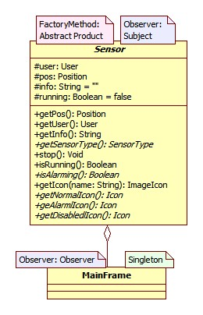
Observer Pattern UI Main Frame and Alarm Event Manager
Observes for any event generated by sensor.
Change the sensor image as per state change
public void update(Observable arg0, Object arg1) {
Sensor s = (Sensor) arg0;
JButton b = buttons.get(s);
if (s.isRunning()) {
if (s.isAlarming())
b.setIcon(s.getAlarmIcon());
else
b.setIcon(s.getNormalIcon());
} else {
b.setIcon(s.getDisabledIcon());
}
}
}

Slide 9
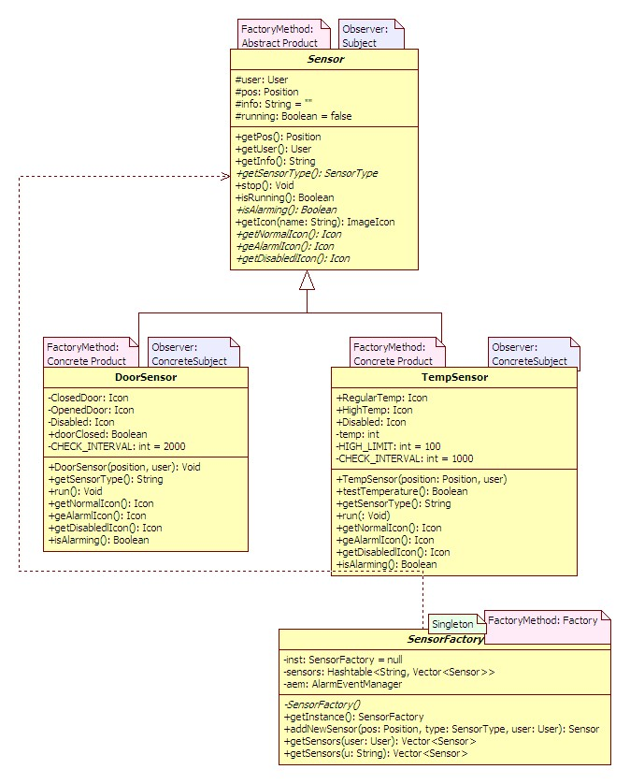
Factory Method Sensor
a slight variation to GOF factory method – No abstract factory; directly concrete factory
addSensor method takes Sensor type as input to create object of concrete sensor class dynamically
public synchronized Sensor addNewSensor(Position p, SensorType type, User u) ;
if (type == SensorType.DOOR_SENSOR) {
s = new DoorSensor(p, u);
} else if (type == SensorType.TEMPERATURE_SENSOR) {
s = new TempSensor(p, u);
} else {
System.out.println("Unknown sensor type");
return null;
}

Slide 10
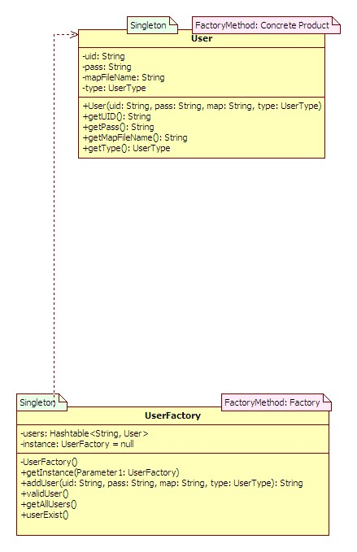
Factory Method User
validate user information before giving access.
public String addUser(String uid, String pass, String map, UserType type) {
// If the UID exists, simply return error message.
if (users.containsKey(uid)) {
return "User ID already exists";
}
users.put(uid, new User(uid, pass, map, type));
return null;
}

Slide 11
Singleton
AlarmEventManager
SensorFactory
UserFactory
All UI forms

Slide 12
Security Patterns
Single Access Point → Login Form
Check Point → UserFactory
Role → Future extension
User can be end client/ system administrator.
System Administrator – GUI Console
End User – Remote client Login
Session → Sockets maintain session. Broadcast to all clients registered on port 12345
Full view with Errors/ Limited View without errors
Limited View
System Administrator – GUI Console
End User – Remote client Login

Slide 13


